Slide 1

Result Management System
Group members
Himu Roy (210201011)
Mahin Reza (210201016)
Muammar Tejwar(210201024)
Fahmid Faisal Fahim(210201030)
Supervisor:
Hasan Muhammad Kafi
Assistant Professor
Department of Computer Science and Engineering
Bangladesh Army University of Science and Technology

Slide 2
Introduction
Made for students
No more hassles
Suitable accommodations for every student

Slide 3
Problem
Lost of data
Miscalculation
Data corruption
Hard to edit afterwards
Hard to access

Slide 4
Objectives
Make it easy to maintain results of an institution
Hassle free result publish
Easy for students to access

Slide 5
🔨 Tools
HTML
CSS
Boostrap 5
PHP
MYSQL
JavaScript

Slide 6
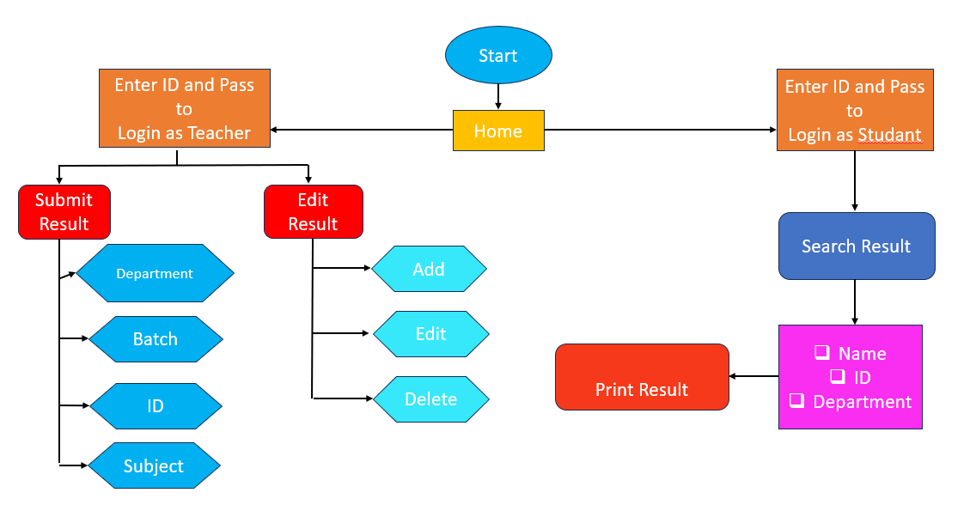

Slide 7
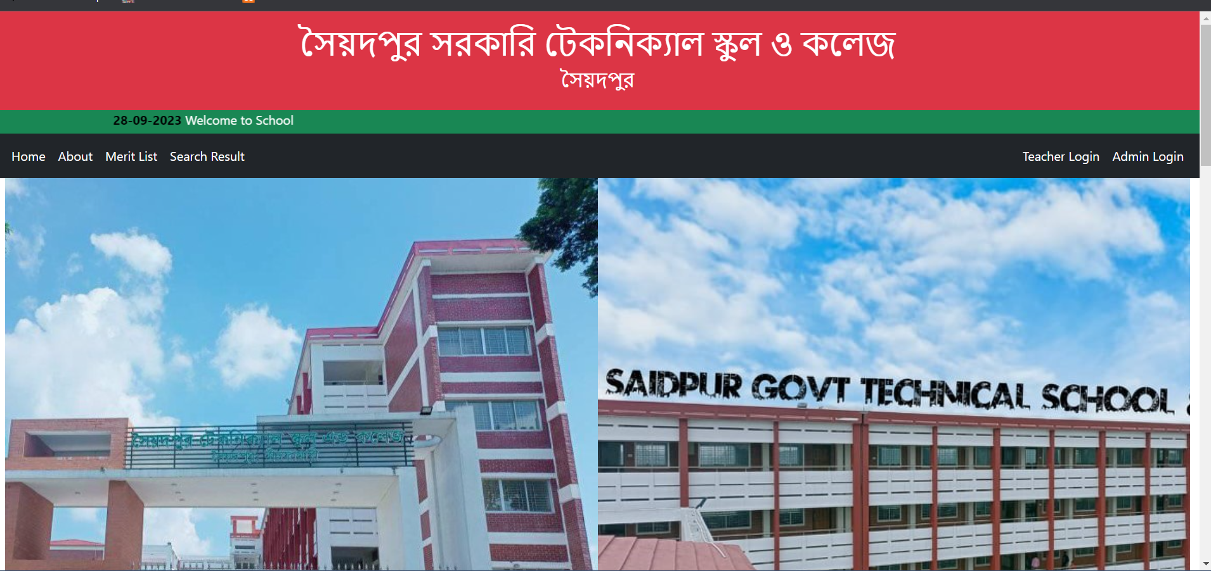
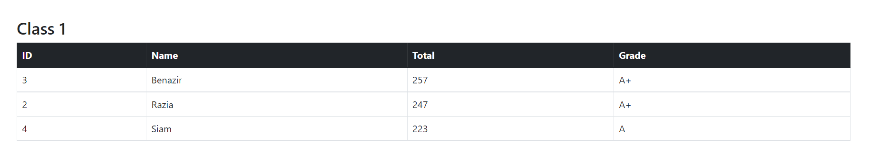
Home Page
Contents
Header
Notice Bar
Navegation Bar
Top Three Result

Slide 8
Admin Panel
Admin
Edit Admin
Student
Search Result
Edit Notice

Slide 9
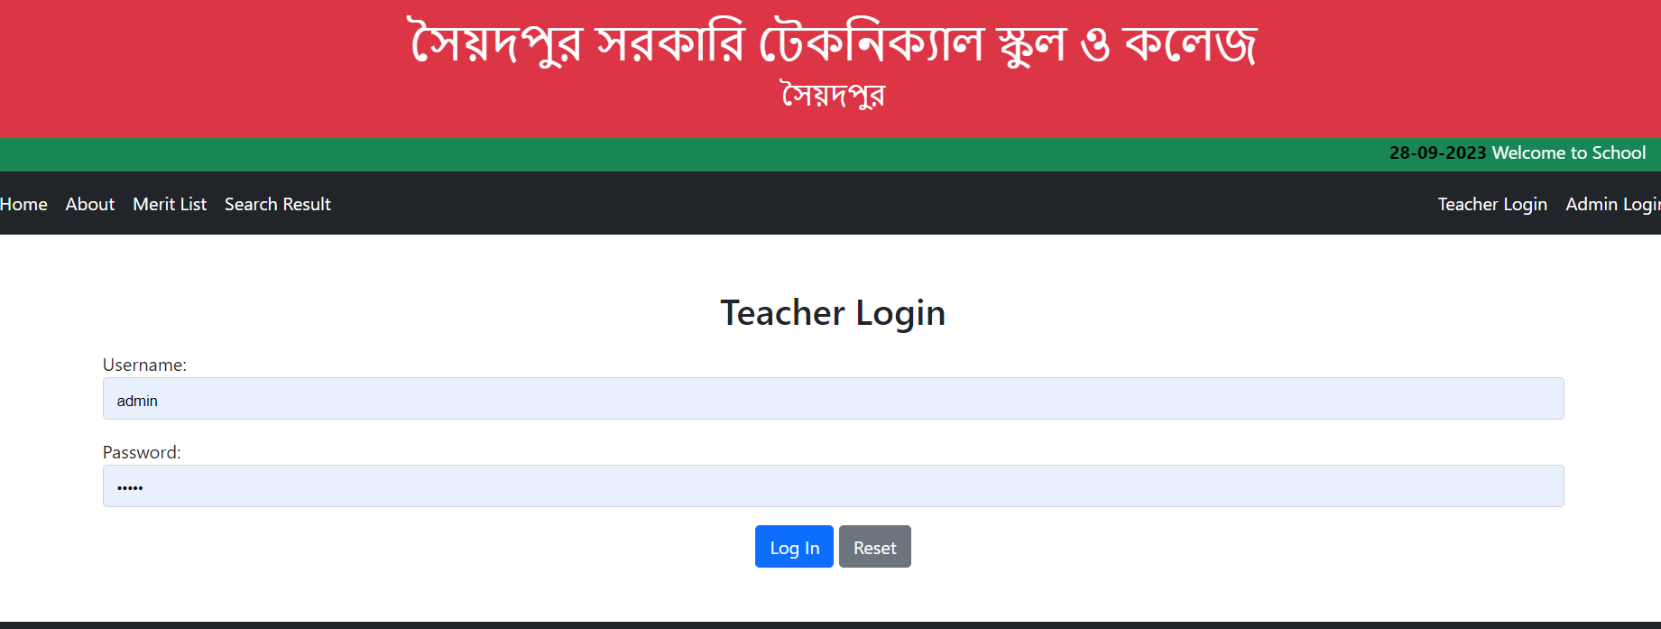
Admin Login
Admin Login
Insert Username
Insert Password
Login

Slide 10
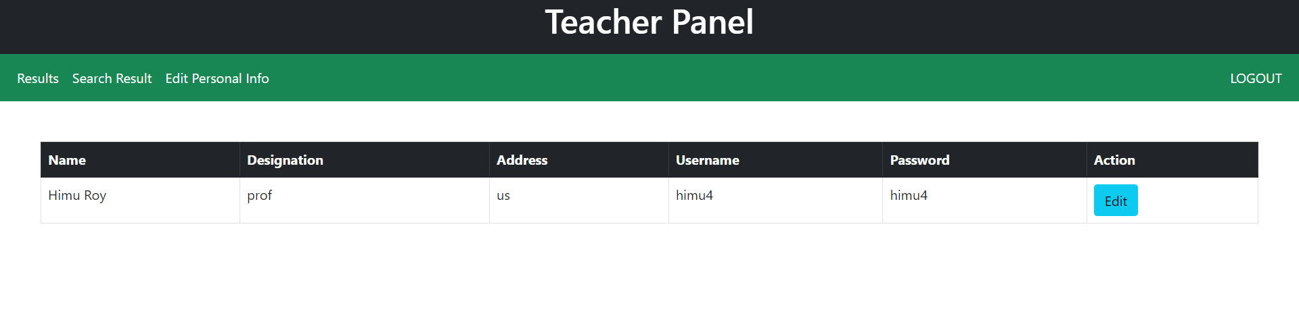
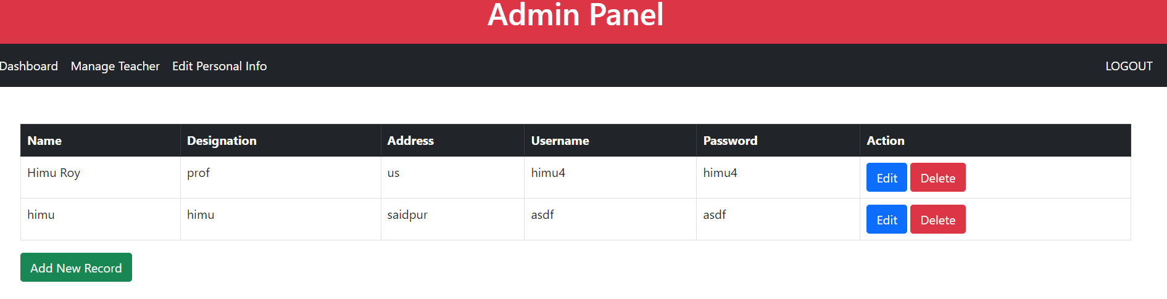
Admin panel >Edit Teacher /Edit Admin
Record Edit
Teacher Edit
Admin Edit

Slide 11
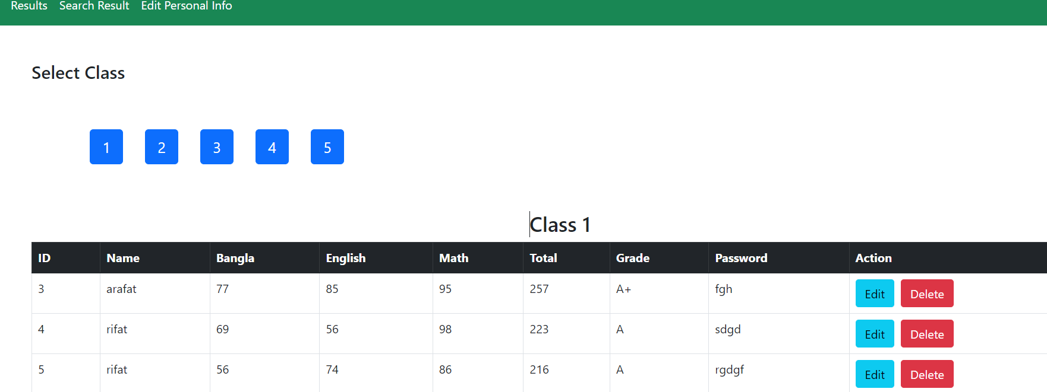
Teacher panel

Slide 12
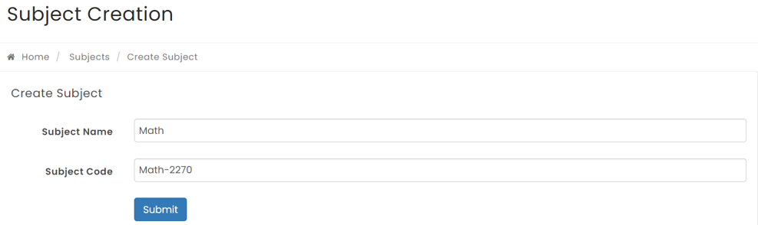
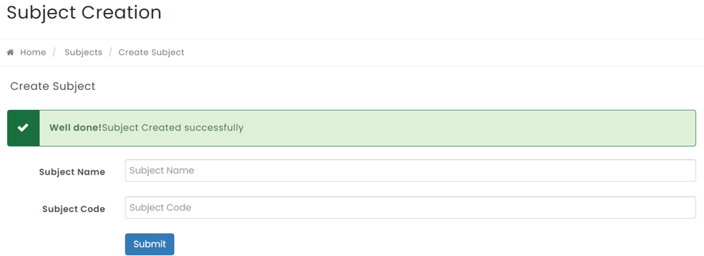
Admin panel > Subject Creation
Student
Select subject

Slide 13
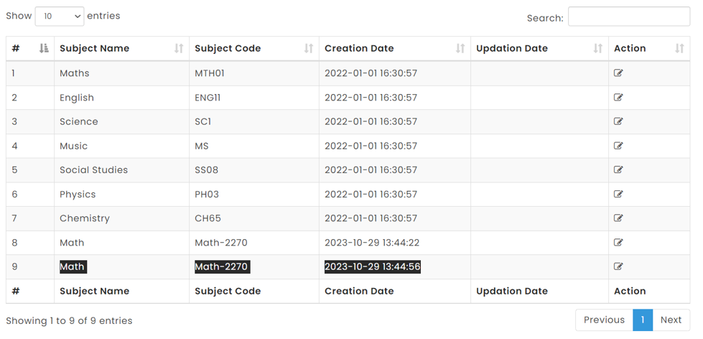
Admin panel > Subject Creation
Student
Add new record
Edit record
Delete record

Slide 14
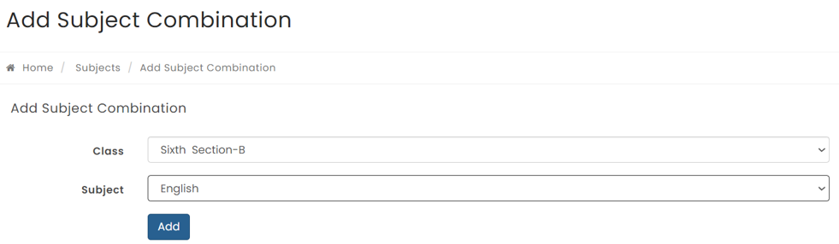
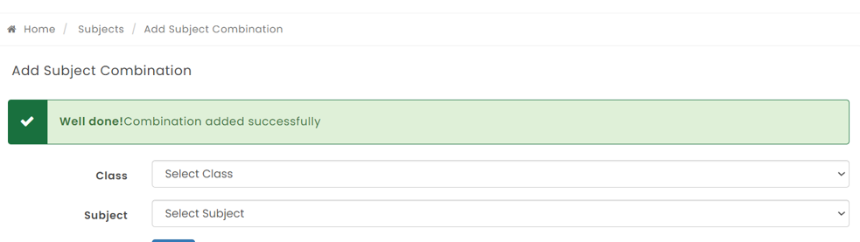
Admin Panel > Add Subject Combination
New data added

Slide 15
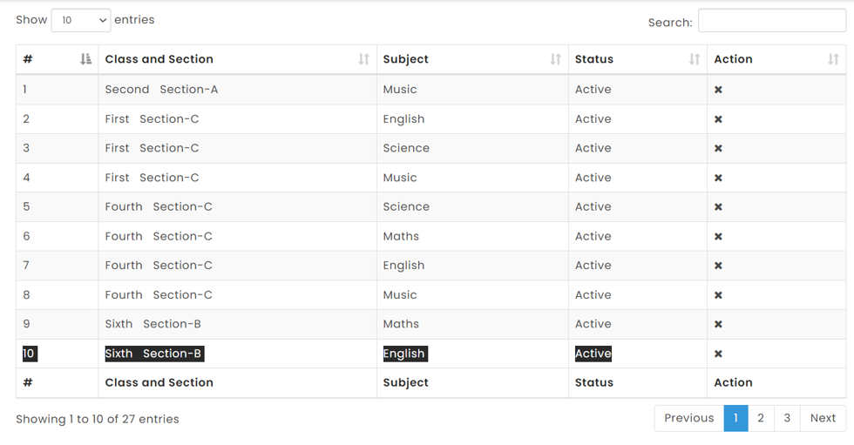
Admin panel > Subject Combination

Slide 16
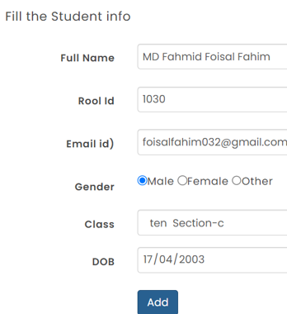
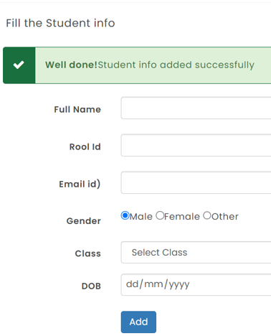
Admin Panel > Student Registration
Student
Only shows the admin who logged in

Slide 17
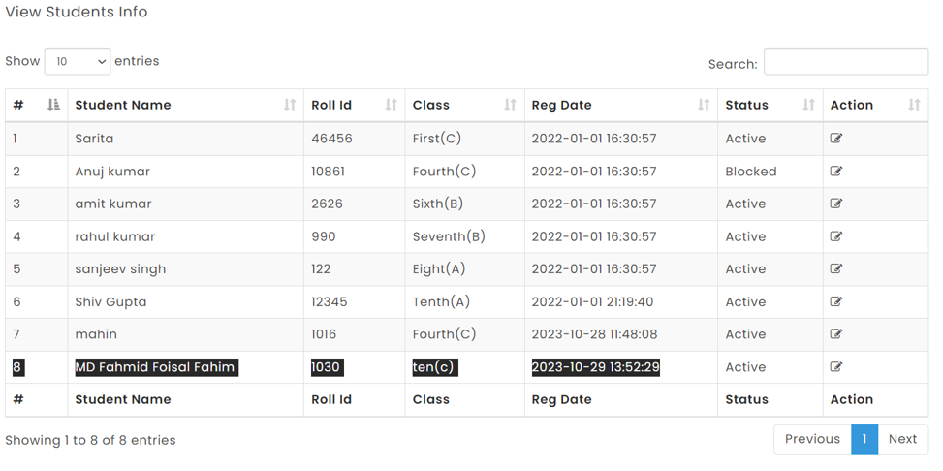
Admin Panel > Info Update
Student Edit
Edit record

Slide 18
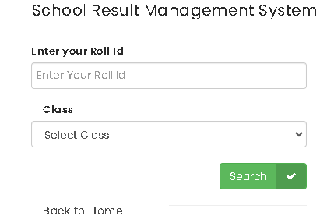
Searh Result Interface
Showed Result after search

Slide 19
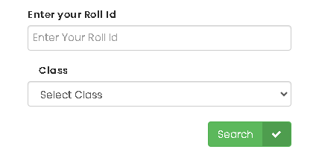
Searh Result
Search Specific Result
Select Roll
Select Class
Search

Slide 20
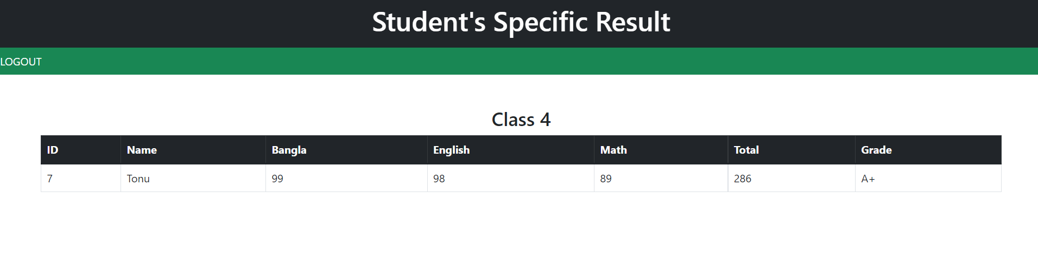
Student Result

Slide 21
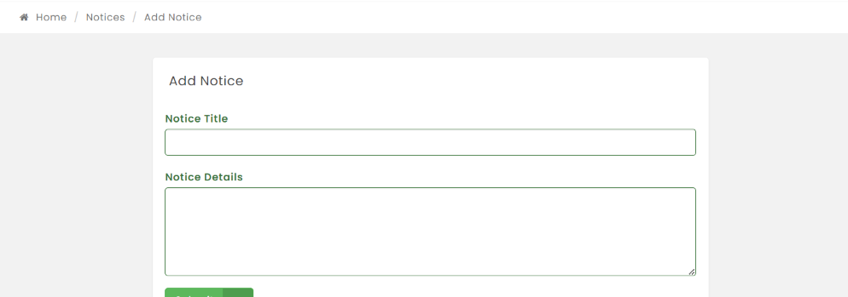
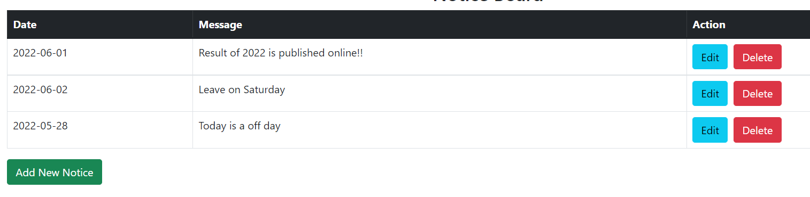
Admin Panel > Edit Notice
Notice
Add New Notice

Slide 22
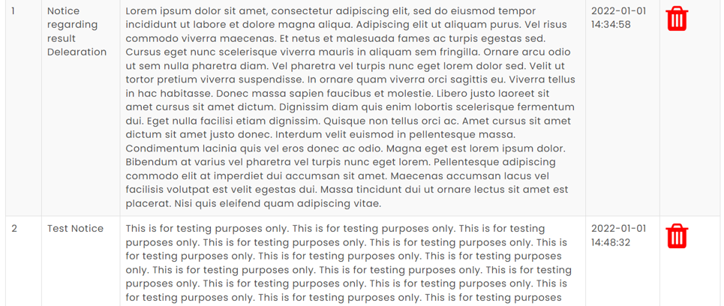
Admin Panel > Edit Notice > OUTPUT

Slide 23
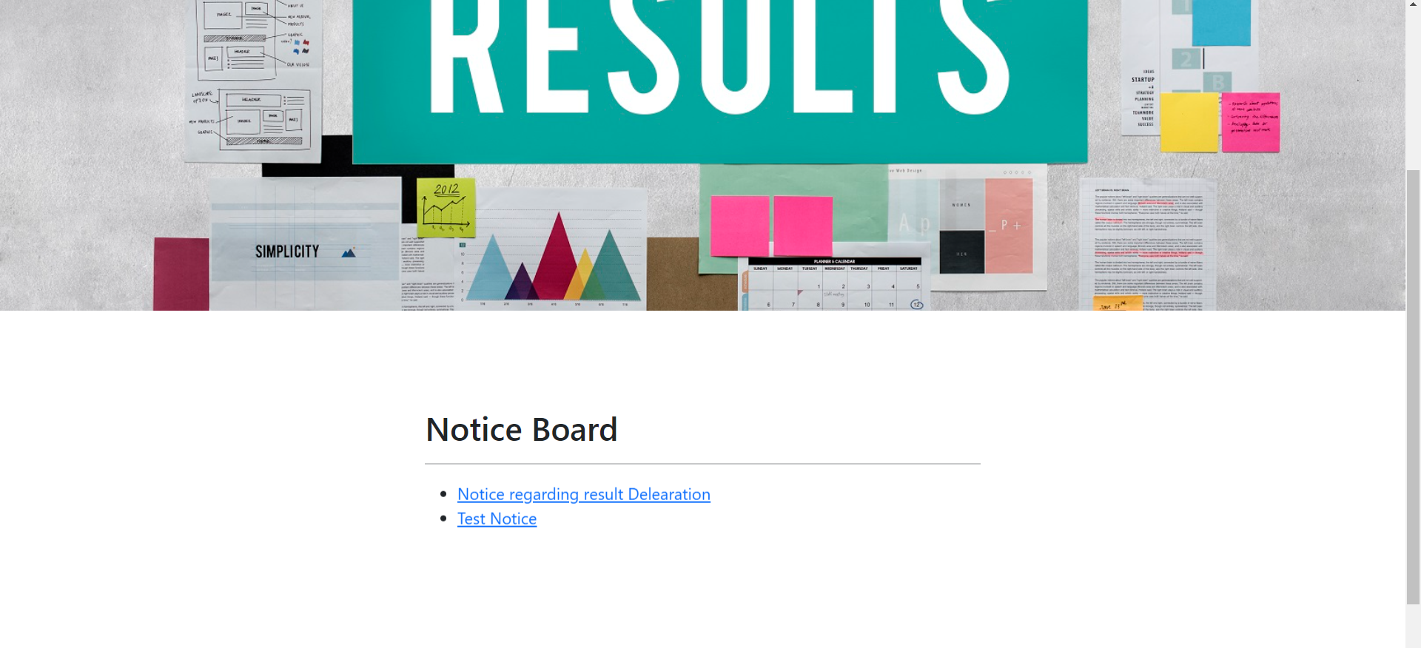
Home Page > Notice Bar
Notice Bar
Shows Notice from Database
Latest 3 notices
Shows Date
Moving

Slide 24
Ftuture Works
We will add teachers login
We will add filteration of failed students
Student registration

Slide 25
Conclution
10%
We have try to make a result management web site
Student can easy to access their result

Slide 26
THANK YOU!

